Slide 1
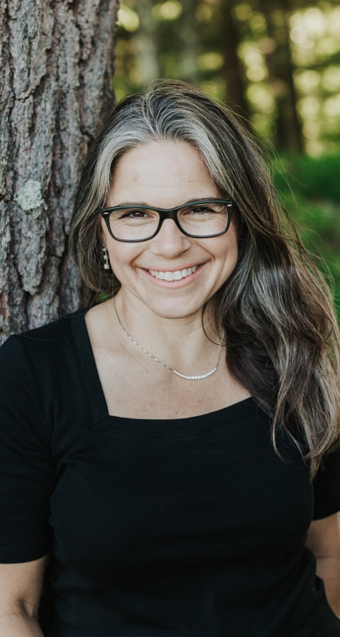
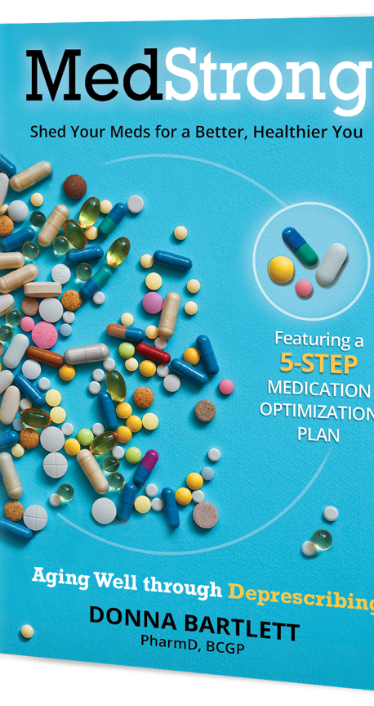
Is it Age or Medication?
Board Certified Geriatric Pharmacist
Dr. Donna Bartlett
will be speaking about better health by
REthinking the MEDications You take!
The REMEDY for being overmedicated.
_______________________________
Come learn how to be MedStrong!
*<WHERE> *<DATE > *<TIME>*
Books will be available for purchase.

